Slide 1
SS ZG 526: Distributed Computing
Unstructured Peer-to-Peer Networks
Chittaranjan Hota
Professor, Dept. of Computer Sc. & Information Systems
BITS, Pilani Hyderabad Campus, Hyderabad
hota@hyderabad.bits-pilani.ac.in

Slide 2

Data Indexing and overlays
The data in a P2P network is identified by using indexing. Data indexing allows the physical data independence from the applications.
Indexing mechanisms can be classified as:
Centralized
Local
Distributed
Centralized indexing uses one or few central servers to store references (indexes) to the data on many peers.
The DNS lookup as well as the lookup by some early P2P networks such as Napster used a central directory lookup.
Birla Institute of Technology and Science, Pilani (Deemed University)

Slide 3

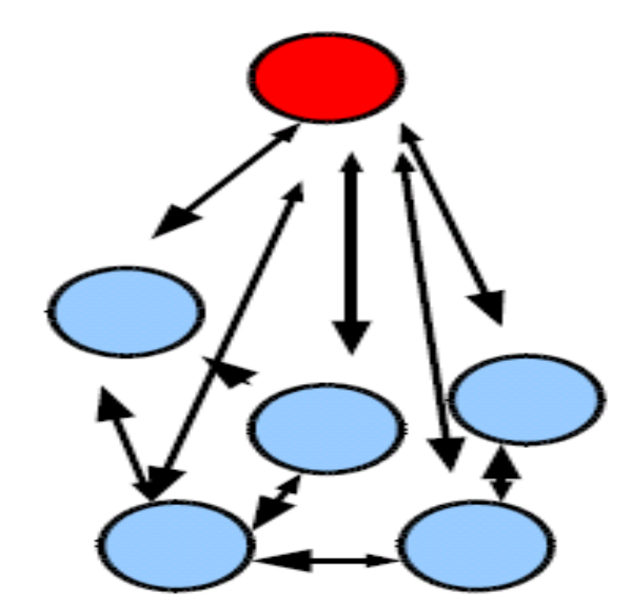
Napster: Centralized architecture
Centralized Lookup
  Centralized directory services
  Steps
    Connect to Napster server.
    Upload list of files to server.
    Give server keywords to search the full list with.
    Select “best” of correct answers
  Performance Bottleneck
Lookup is centralized, but files are copied in P2P manner
Birla Institute of Technology and Science, Pilani (Deemed University)

Slide 4

Data Indexing and overlays
Local indexing requires each peer to index only the local data objects and remote objects need to be searched for.
This form of indexing is typically used in unstructured overlays in conjunction with flooding search or random walk search.
For example: Gnutella uses local indexing.
Birla Institute of Technology and Science, Pilani (Deemed University)

Slide 5

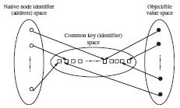
Data Indexing and overlays
Distributed indexing involves the indexes to the objects at various peers being scattered across other peers through-out the P2P network. In order to access the indexes, a structure is used in the P2P overlay to access the indexes. Distributed indexing is the most challenging of the indexing schemes, and many novel mechanisms have been proposed, most notably the Distributed Hash Table (DHT).
Birla Institute of Technology and Science, Pilani (Deemed University)

Slide 6

Classification of P2P overlay networks
Structured overlay networks
  Are based on Distributed Hash Tables (DHT)
  The overlay network assigns keys to data items and organizes its peers into a graph that maps each data key to a peer.
Unstructured overlay networks
  The overlay networks organize peers in a random graph in flat or hierarchical manner.
Birla Institute of Technology and Science, Pilani (Deemed University)

Slide 7

Unstructured P2P Networks
An Unstructured system composed of peers joining the network with some loose rules, without any prior knowledge of the topology.
Network uses flooding or random walks as the mechanism to send queries across the overlay with a limited scope.
When a peer receives the flood query, it sends a list of all content matching the query to the originating peer.
Examples: FreeNet, Gnutella,KaZaA, BitTorrent
Birla Institute of Technology and Science, Pilani (Deemed University)

Slide 8

BitTorrent
To share a file or group of files, the initiator first creates a .torrent file, a small file that contains Metadata about the files to be shared, and Information about the tracker, the computer that coordinates the file distribution.
Downloaders first obtain a .torrent file, and then connect to the specified tracker, which tells them from which other peers to download the pieces of the file.
Birla Institute of Technology and Science, Pilani (Deemed University)

Slide 9

BitTorrent Language
Seeder = a peer that provides the complete file.
Initial seeder = a peer that provides the initial copy.
Leecher
Initial seeder
Leecher
Seeder
Source: S Ghosh, uiowa
Birla Institute of Technology and Science, Pilani (Deemed University)

Slide 10


Simple example
{1,2,3,4,5,6,7,8,9,10}
Seeder: A
{}
{1,2,3}
{1,2,3,5}
{}
{1,2,3}
{1,2,3,4}
{1,2,3,4,5}
Downloader C
Downloader B
Source: S Ghosh, uiowa
Birla Institute of Technology and Science, Pilani (Deemed University)

Slide 11
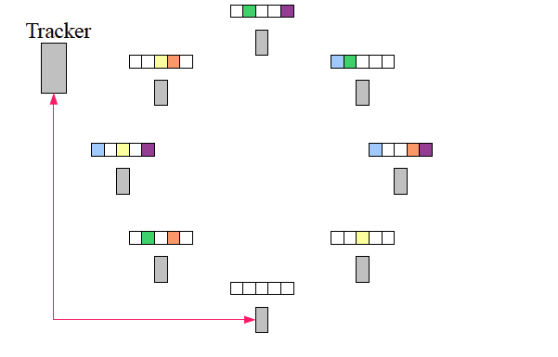

Download in progress
Source: S Ghosh, uiowa
Birla Institute of Technology and Science, Pilani (Deemed University)

Slide 12
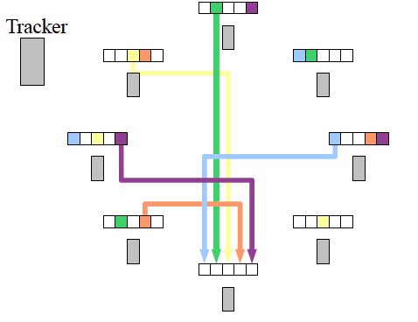
Continued…
Source: S Ghosh, uiowa
Birla Institute of Technology and Science, Pilani (Deemed University)

Slide 13

Gnutella query flooding
fully distributed lookup for files
  no central server
Main representative of Unstructured P2P
Flooding based lookup:
  Inefficient in terms of scalability and bandwidth
Overlay network: graph
edge between peer X and Y if there’s a TCP connection
all active peers and edges in overlay net
Edge is not a physical link
Given peer will typically be connected with < 10 overlay neighbors
Birla Institute of Technology and Science, Pilani (Deemed University)

Slide 14
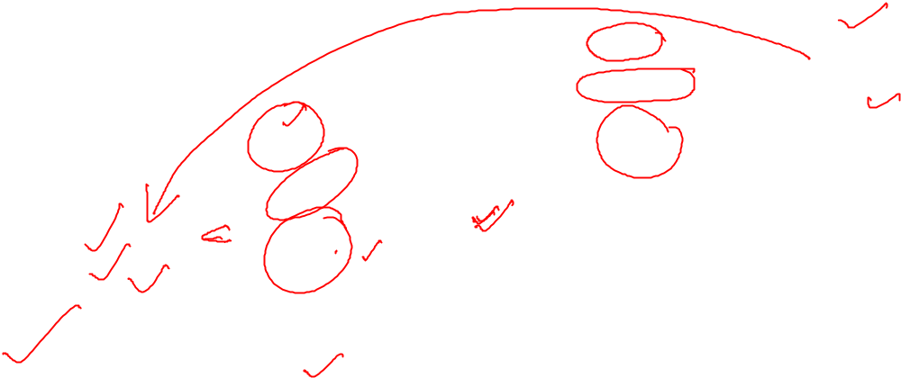

Gnutella protocol
Query message
sent over existing TCP
connections
peers forward
Query message
QueryHit
sent over
reverse
path
Query
QueryHit
Query
Query
QueryHit
Query
QueryHit
Scalability:
limited scope
flooding
Query
Birla Institute of Technology and Science, Pilani (Deemed University)

Slide 15
Message types in Gnutella
Message Type | Description
Ping | Used for topology discovery of the network. A node receiving a Ping message is expected to respond with one or more Pong messages.
Pong | The response to a Ping message. Includes the address of a connected Gnutella node and information regarding the amount of data it is making available to the network.
Query | The primary mechanism for searching the distributed network. Query message includes minimum speed acceptable and the search keywords. A node receiving a Query message will respond with a QueryHit message if a match is found against its local data set.
QueryHit | The response to a Query. This message provides the recipient with enough information like ip, port, speed, and list of matching files. Node makes a TCP connection to acquire the data matching the corresponding Query.
Push | A mechanism that allows nodes behind firewall to contribute a file to the Gnutella network. If requester can’t connect, it sends a “push” message instead, with its IP address and port number. Offerer does an outbound connect to that host, and sends the file.
Birla Institute of Technology and Science, Pilani (Deemed University)

Slide 16

Gnutella search
Flooding based search is extremely wasteful with bandwidth
  A large (linear) part of the network is covered irrespective of hits found
  Enormous number of redundant messages
  All users do this in parallel: local load grows linearly with size
What search protocols can we come up with in an unstructured network
  Controlling topology to allow for better search
    Random walk, Degree-biased Random Walk
  Controlling placement of objects
    Replication
Birla Institute of Technology and Science, Pilani (Deemed University)

Slide 17
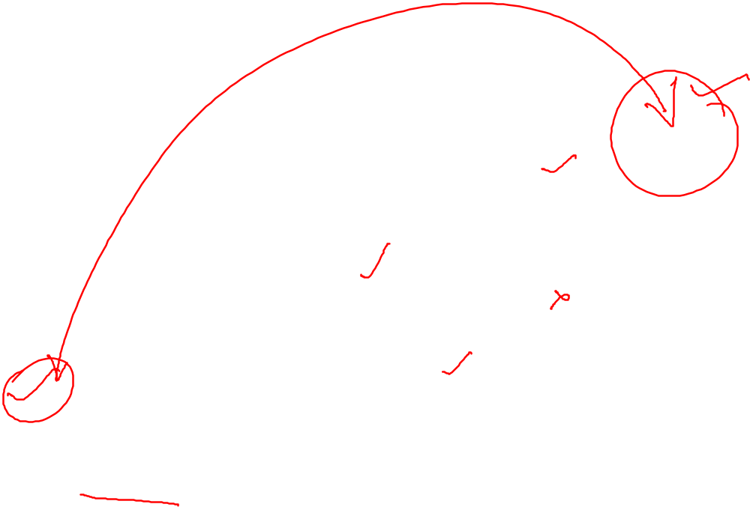
Continued…
G
Object X
Query
Query Hit
F
H
H
E
B
C
D
A
Look up ‘Object X’
Birla Institute of Technology and Science, Pilani (Deemed University)

Slide 18
Next session
Design of Structured-P2P Networks and Security concerns
Birla Institute of Technology and Science, Pilani (Deemed University)

